Slide 1
COMP SCI 1103/2103 Algorithm Design & Data Structure Recursion 3
School of Computer Science

Slide 2
Previously on ADDS
Recursion
Checklist of recursion
How to improve the efficiency of recursion
Recursive helper function: Recall that creating new strings made our isPalindrome so inefficient, but we made it work with only one string
Tail recursion; c++ compilers understands when they can do a tail call elimination

Slide 3
Overview
In this lecture we will discuss:
Improving efficiency through Memoisation
More examples of recursion.
Indirect recursion
Notes:
5min

Slide 4
Improving Efficiency with Memoisation - Trucks Revisited
Memoisation (not a spelling error!): store the obtained results of recursive function calls somewhere, so that you don’t go through it again
For the call numTrucks(10, 2), how many times do we have to recursively call numTrucks(2, 2)?
Instead of making another call, we could store results and lookup in a table
Assumes lookup takes less time than function call and calculation;
How would we redesign numTrucks() to do this?

Slide 5
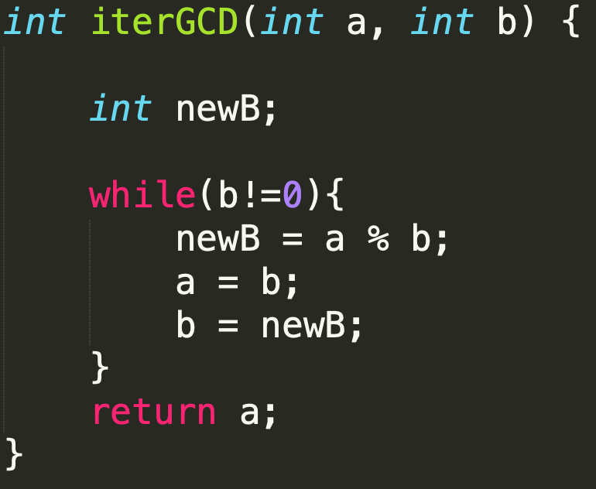
More examples of recursion - Greatest Common Divisor
GCD is a mathematic problem to find the largest positive integer that is divisor of two or more integer
Iterative way
Recursive way
Euclid’s algorithm
gcd(a,b) = gcd(b, a%b)
Is this a tail recursion?
int recGCD(int a, int b){
if(b == 0){
return a;
}
return recGCD(b, a%b);
}
Notes:
20min

Slide 6
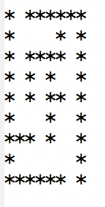
Example - Maze
Escaping a Maze
Some starting position
The walls of the maze are indicated by *.
char * maze[9][9]
Think recursively!
Currently located at [x,y]. Can you escape from here?
Base:
If [x,y] is empty, on boundary, and is not the starting position, then YES!
If [x,y] is not empty, or is out of the boundary then NO.
Recursion: Can you escape from one of the neighboring locations?
Without revisiting the current location (To prevent an infinite loop).

Slide 7
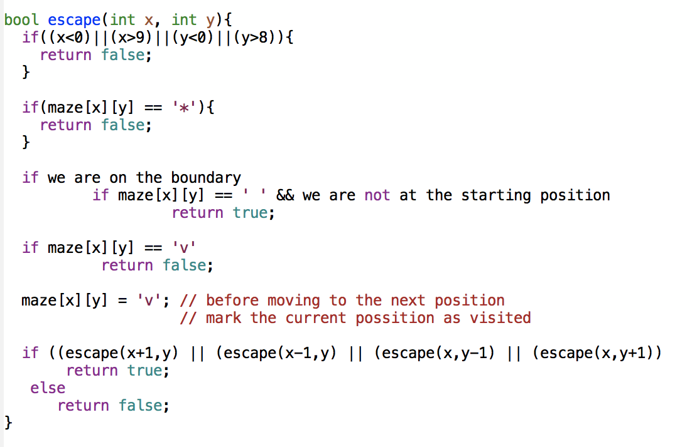
Example - Maze
Pseudo code

Slide 8
Indirect Recursion
So far we’ve looked at direct recursion - a function calling itself.
Indirect recursion occurs when a function calls itself through the intermediary of another function.
For example a function Func1 calls a function Func2, which then calls Func1 again.
Func1
Func2

Slide 9
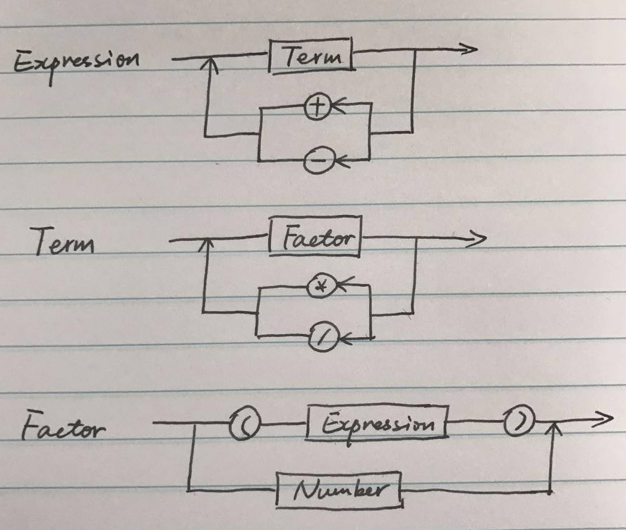
Example
Compute the values of arithmetic expressions
Example
3+4*5
(3+4)*5
1+(2+(3+(4+5)))
Is there an infinite loop?
Notes:
As always, with a recursive function, you need to ensure that the recursion terminates. In this situation, if getExpressionValue() calls itself, the second call works on a shorter expression than the original one. At each recursive call, at least some of the tokens of the input string are consumed, so eventually the recursion must come to an end.

Slide 10
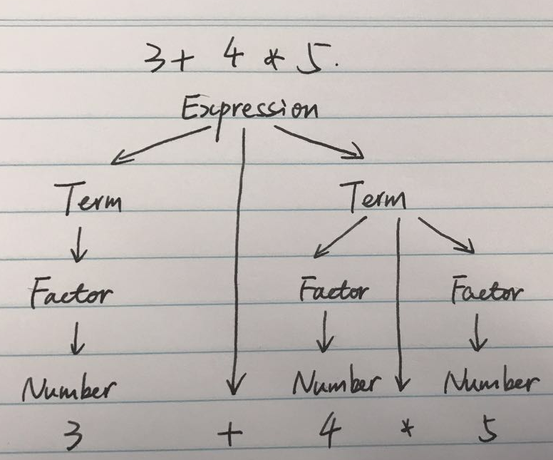
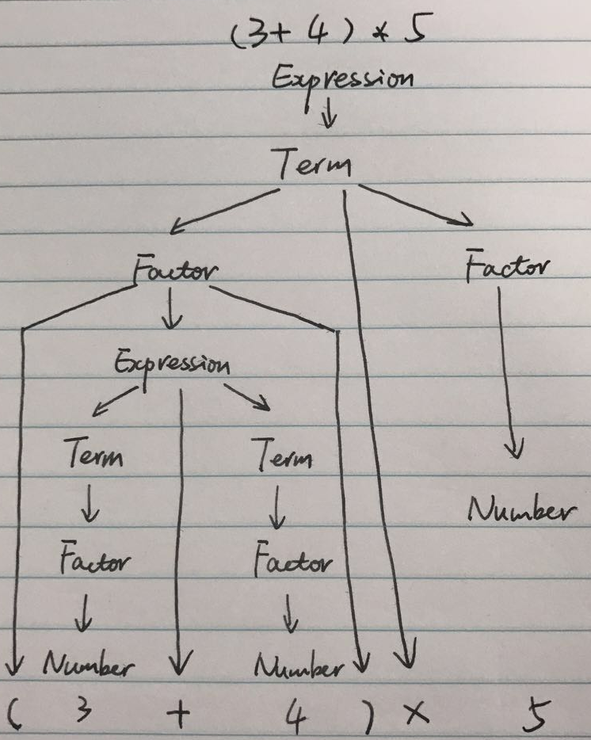
Example
Syntax tree for 3+4*5
(3+4)*5

Slide 11
Sample code for getExpression
Assume we have
getChar() looks ahead in input string
removeChar() removes a char from input string
getNumber() reads a number from the input string and removes the corresponding characters from that
How can we write getExp() using these helper functions?

Slide 12
example code
int getTerm(){
int value = getFactor();
char next = getChar();
while ((next ==‘*’) ||(next==‘/’)){
removeChar();
int value2 = getFactor();
if(next ==‘*’)
value *= value2;
else
value /= value2;
}
return value;
}
int getExp(){
int value = getTerm();
char next = getChar();
while ((next ==‘+’) ||(next==‘-’)){
removeChar();
int value2 = getTerm();
if(next ==‘+’)
value += value2;
else
value -= value2;
}
return value;
}
int getFactor(){
int value;
char next = getChar();
if(next==‘(’ ){
removeChar();
value = getExp();
removeChar(); // discard ‘)’
}else
value = getNumber();
return value;
}
int getFactor(){
char next = getChar();
if(next ==‘(’) {
value = getExp();
removeChar();
return value;
}
else
return getNumber();
}
Notes:
As always, with a recursive function, you need to ensure that the recursion terminates. In this situation, if getExpressionValue() calls itself, the second call works on a shorter expression than the original one. At each recursive call, at least some of the tokens of the input string are consumed, so eventually the recursion must come to an end.

Slide 13
Example
For calculating (3+4)*5
getExp()
getTerm()
getFactor() ->consume ‘(’
getExp() ->3+4, return 7
->consume ‘)’
getFactor() –> return 5
7*5 -> return 35
return 35

Slide 14
Summary
Recursion is a useful tool for understanding problems and producing readable solutions.
In designing recursive functions, we need to keep in mind the two important factors of recursion
Base cases
Recursion relationship
We saw More examples of recursion
Indirect recursion
Harder to track and control

Slide 15
Notes:
Save as a PowerPoint Show and upload to your MyUni course.
Before you upload the PPS customise slides and indicate where students will find them.

